Slide 1
Craig Erickson, CISSP, CISA
Data Governance enables us to achieve our mission
Data Quality Counsel
Notes:
Recently I changed the title on my LinkedIn Profile in an attempt to find job opportunities in my professional practice of Data Governance. As Information Security Analyst, Compliance Program Manager, Solutions Architect, and Data Scientist with more than 20 years combined experience in managing secure software development and IT operations, I’m always asked, “What do I really want to do?” What am I passionate about? Where do I want to go in my career?”

Slide 2
Data about our customers
Market research
Customer Behavior, Profiles & Preferences
Security, Privacy, Contractual Agreements
Sources include: CRM, ERP, Data Lakes, BI Analytics, machine log data, legal, etc.

Slide 3
Data about our products
Market research, consumer ratings
Product Specifications, Cost and Price data
Acceptable Use Agreements, Patents, Warrantees
Sources include: PIM, ERP, Catalogs, Inventory, user guides, BOM, legal, etc.

Slide 4
Data about our processes
Transaction audit trails and User Access Reviews for SOX, VISA Key Injection
Information Security Assessments, ISO 9000, PCI-DSS, SSAE16 SOC, etc.
Financial and Operational Reporting, SDLC, log management, change management
Sources include: ERP, Audit & Certification Reports, EDW/BI, etc.

Slide 5
Data we use to make decisions
Is the data flawed?
How would we know? Are there absolute standards for data quality?
Why should we believe the data?
- Are the sources reliable? Has it been transformed or processed in a way that reduces its value?
Data we use to manage risk
Notes:
Information Security and Compliance are broad domains that have huge impacts on organizations.
If I had to choose just one discipline or focus within my profession, I would choose data quality. The reason is pretty simple: if the data is bad, so are the assessments, the alerts, the audits, and most important of all, the decisions managers make to manage the risks of NOT meeting their objectives.
If information is based on data that is NOT factual, we have a fundamental problem.
If data facts are disputed, we also question the information these facts represent, and by extension, often question the messenger’s credibility in disseminating information, then we have a critical logistical problem: we cannot communicate effectively.

Slide 6
ISO 8000 - Data Quality
ISO 8000 is an international standard which measures the quality of an entities’ data management. The standard requires that a specific request for the exact requirement be made.
This informs the data owner what they need to provide which allows the requestor to measure how well that requirement was met.
Standards for Master Data characteristics:
Syntax, semantic encoding, and conformance to data specification, provenance, accuracy, and completeness.
ISO 22745 is an international standard which facilitates the mapping of
terminology dictionaries to a single source.
This in turn facilitates translation of terminology from one entity to another based
on an XML schema.

Slide 7
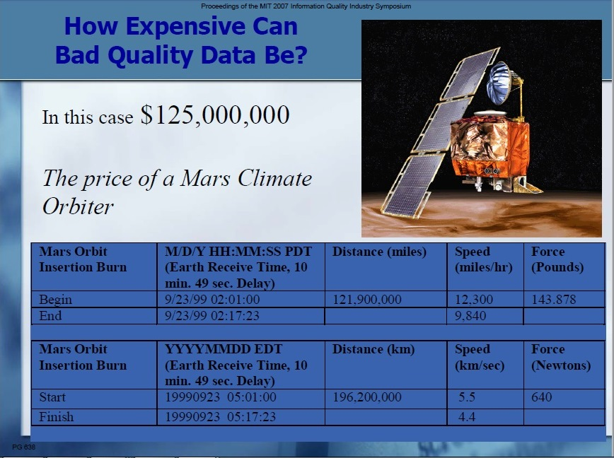

Slide 8
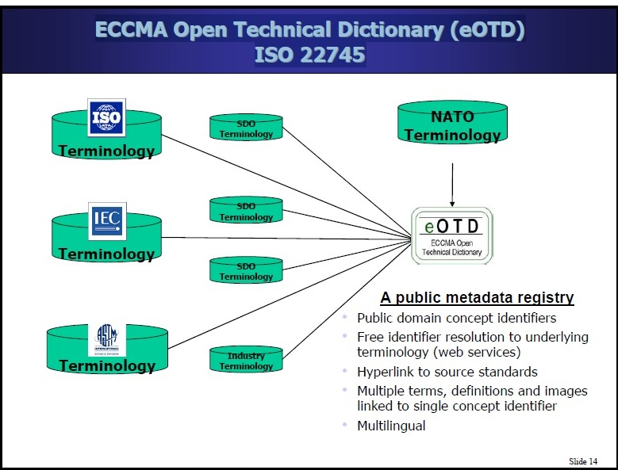

Slide 9
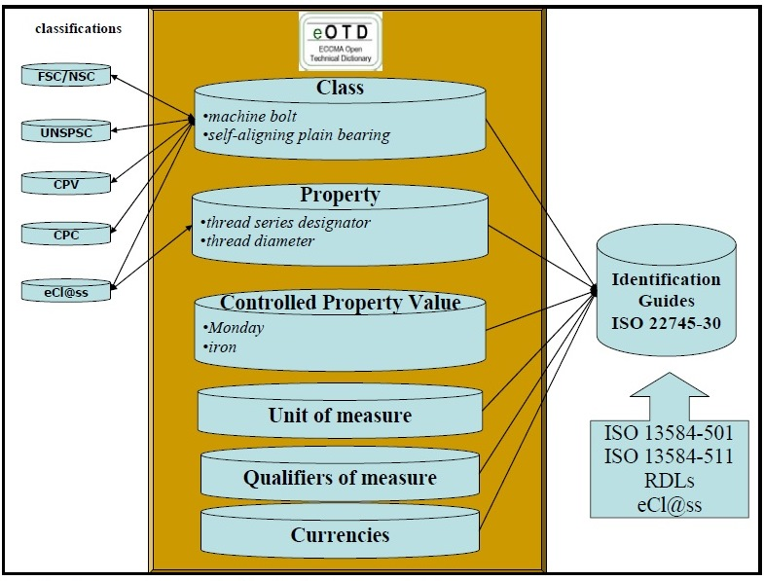

Slide 10
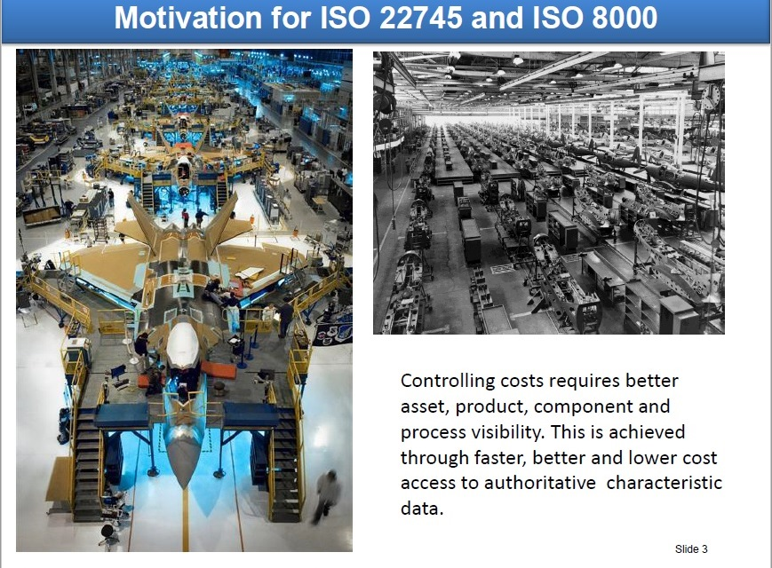

Slide 11
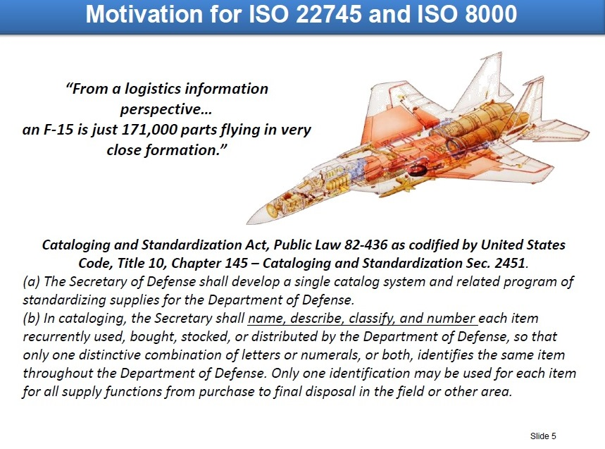

Slide 12














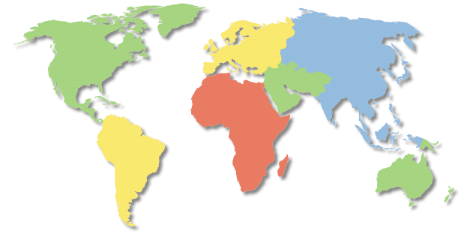
SISP Jumpstart Operational View (OV-1)
(4 November 2003 Version 0.5)
SOPS
AOC

Slide 13
Global Space Snapshot
Data Governance issues encountered by the Air Force Space Command for ascertaining the operational readiness of military assets
Technical Questions:
Business Questions:
What data is required for the satellite positions?
Do the satellites move to reflect the actual location on the equator?
How many data elements total comprise the overall rating of SSN/SSA color?
What are the business rules that result in the specific color change?
Are the components of each attribute stored in a database?
Process (Governance) Questions:
Who is the designated data source?
Are there SLAs in place to insure an agreed to data standard, i.e. update frequency, availability, etc.?
What are the exact processes and procedures required to input the data?
Who is the point of contact on behalf of data sources and users?

Slide 14
Enterprise Risk Management Technology
Architecture Roadmap
Craig built a working POC for AIG prior to the 2008 financial crisis
Enterprise Risk Management Technology
May, 2006

Slide 15
What do we mean by Risk Data?
Reference Data
Transactions/
Business Events
Market Data
Risk Results
Documents
Transactions
Holdings / Positions
Cash Flows
Limits / Facilities
Security / Product / Instrument
Parties
Employee
Account Portfolio
Assets / Liabilities / Collateral
CP Hierarchies
Ratings
Rating Agencies
AIG Organization
Currency
Risk Parameters
Geography
Industry Classification
Netting Nodes
Master Agreements / Contracts / Policies
Alert List
Calendars
Look-ups / Code Tables
Cross References
IR Curves
Security Prices
Price Curves
Price Surfaces
Time Series
Exchange Rates
Macro Economic Data
Ratings Changes
Scenarios
Corporate Actions
News
Volatility Correlations
Research
Approval Documents
Policies & Procedures
Exposure
Overage
VaR
Default Probability
Loss Given Default
RAROC
MTMs
MTFs
Cash Flow Projections
Key Rate Sensitivity
Scenario Results
Across all Reference Data
Processed Market Data
Notes:
Black rectangles represent areas I have direct experience with… currently I am learning R, Python, Pandas and machine learning algorithms to dive deeply into data quality so I can use these tools to verify that lower and upper thresholds are set appropriately for aggregated operational credit risks.
Estimate Regression with (Type-I) Pareto Response
The Type-I Pareto distribution has a probability function shown as below f(y; a, k) = k * (a ^ k) / (y ^ (k + 1)) In the formulation, the scale parameter 0 < a < y and the shape parameter k > 1 .
The positive lower bound of Type-I Pareto distribution is particularly appealing in modeling the severity measure in that there is usually a reporting threshold for operational loss events. For instance, the reporting threshold of ABA operational risk consortium data is $10,000 and any loss event below the threshold value would be not reported, which might add the complexity in the severity model estimation.
In practice, instead of modeling the severity measure directly, we might model the shifted response y` = severity – threshold to accommodate the threshold value such that the supporting domain of y` could start from 0 and that the Gamma, Inverse Gaussian, or Lognormal regression can still be applicable. However, under the distributional assumption of Type-I Pareto with a known lower end, we do not need to shift the severity measure anymore but model it directly based on the probability function.

Slide 16
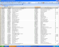









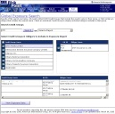
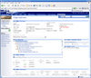
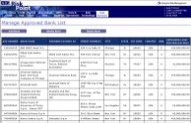
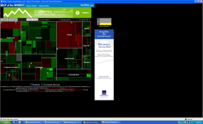
Business Architecture
Internal
Data
Data
API’s
Source
Data
Quality
Source
Staging
Data
Normalization
And
Transformation
(matching)
Data
Catalog
Metadata
(Subscription)
Dynamic
Data
Enrichment
Data Storage
Data Distribution to Analytics & Decision Support
Data Provisioning Lab
(Fast Track)
Data Analysis
Data
Provisioning
External
Data
BU Risk Results Consolidation
Data Application Staging
Scenario Generation & Distribution
Model Library with metadata
Analytical Engines
Risk Results Storage
Risk Analytical Services
NPV
Sensitivities
VaR
Duration
Credit Exposure
Cash Flows
Economic Capital
Economic Capital Engine
Analytics
Layer
AIG EC
Decision
Support
Reports
(Cognos)
MIS Hierarchy Management
Workflow
Information Analytics
Visualization
Notification Services
CRM Global Exposures
CRM
ORR Management
CRM Limit Management
CRM Credit Approval
Party Dashboard
MRM Exposure Management
MRM Limit Management
MRM Market Approval
Operational Risk App
Economic Capital App
Distribution
RiskPortal,
Data Portal
RiskPortal,
CRM Portal
RiskPortal,
MRM Portal
RiskPortal,
ORM Portal
RiskPortal,
Economic Capital Portal
RiskPortal,
Policies & Procedures

Slide 17
Application Classification
Portal
Mobile
Shared
Workflow
Application Dashboards
Operations Dashboard
Ad-hoc Analysis
Reporting
Credit Approval
Market Risk Middle Office
ORR Management
Limits Management
Policies & Procedures
Economic Capital
Research & Development
Presentation
Analytics
& Simulation
Market Risk
Credit Risk
Actuarial Risk
Liquidity Risk
Operational Risk
Data Analytics
Data Remediation
Data Integration
Assumptions Management
Data
Reference & Holdings
Market Data
Risk Results
Reporting Data
(Hierarchies)

Slide 18

ERM Data Flow
Exception Management
Errors
Alerts
Application Staging
Risk Applications
CRM
MRM
ORM
Staging
Persistence
Data Provider
Reference
Transactions
Market Data
Documents
Extract
Risk Results
Reference Data Consumption
Party
Instruments
Hierarchy
Ratings
Apply Rules
Transform
Apply Rules
Market Data
AIG Internal
Normalize
Corporate Services
✔
Transaction (Risk) Data Consumption
Match
Normalize
Domestic General Insurance
✔
✔
Transaction Data
Enrich
Financial Services
✔
✔
✔
✔
Foreign General Insurance
✔
✔
Filter
Aggregate
Life Insurance & Annuities
✔
✔
Holdings
Exposures
Netting
Master - Agreements
Retirement & Asset Management
✔
✔
Reference Data
External
String Validate
Load
Manual
RiskMetrics Group
✔
✔
Market Data Consumption
Dun & Bradstreet
✔
Reporting & Analysis
Standard & Poors
✔
Quality Check
Fitch Ratings
✔
Documents
Bloomberg
✔
✔
Reuters
✔
✔
Load
History
Other AIG Corporation Applications
External Cleansing Service
Market Data
Metadata
Data Security
Models and Standards

Slide 19
Data Architecture
OCIO Definition
“…standards and methodology that guide the creation and use and management of data and the deployment of data related technologies…”
Which to us means:
Data supported by a common and leverageable/reusable infrastructure, that is:
Standardized – for format and content
Quality Controlled – agreed metrics for accuracy, timeliness and traceability
Managed – common processes for monitoring and recording exceptions, outliers, missing data; tools for interrogating and correcting issues
Secure – permissioned, encrypted where necessary by classification
Accessible – via applications, reporting and add-hoc queries

Slide 20
Security Architecture – End State
Platform Infrastructure
Data / Information
Network Infrastructure
Software / Applications
Network Security
Firewalls
Demilitarized Zone
Demilitarized Zone
External Connections
Wireless Access
Network Access
Intrusion Detection
Vulnerability Scanning
Malicious Code
Account Management
Authentication
Directory Services
Session Controls
Encryption
Incident Tracking
Maintenance
Backups
Media Sanitizing
Data Classification
Database Access
IT Risk Management
Configuration Mgmt.
BCP / DR
Notes:
What does Data Governance and Data Quality have to do with Information Security?

Slide 21
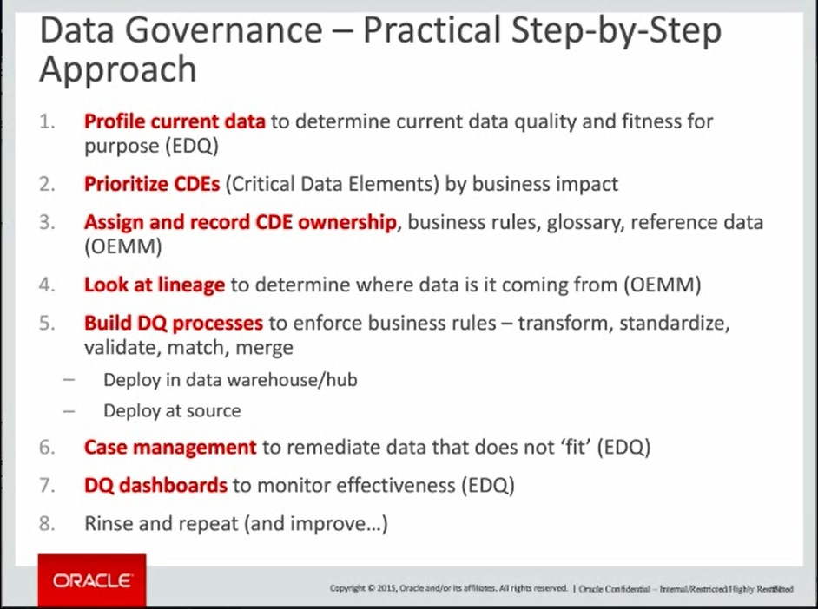

Slide 22
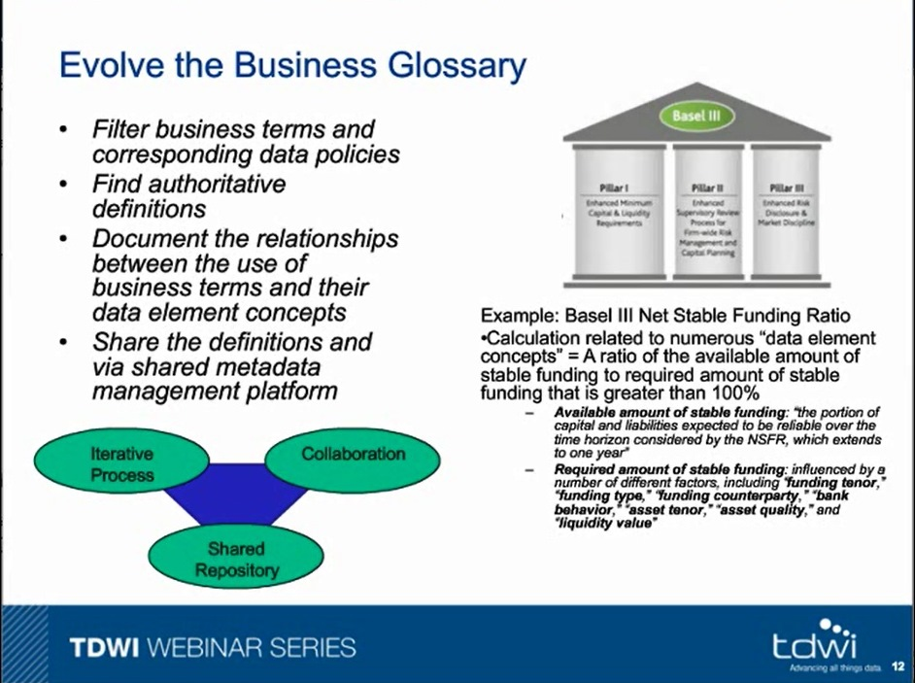

Slide 23
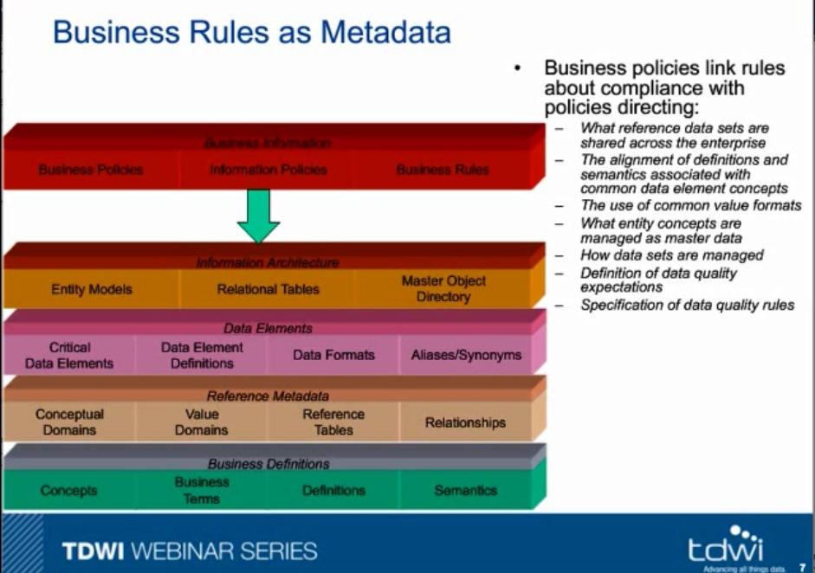

Slide 24
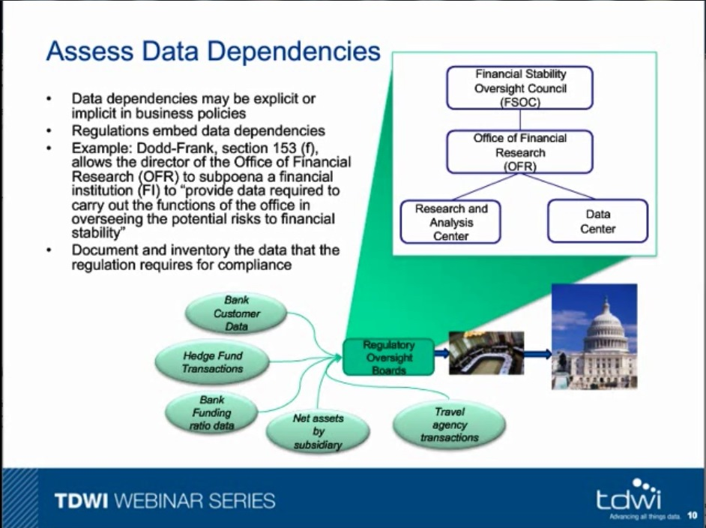

Slide 25
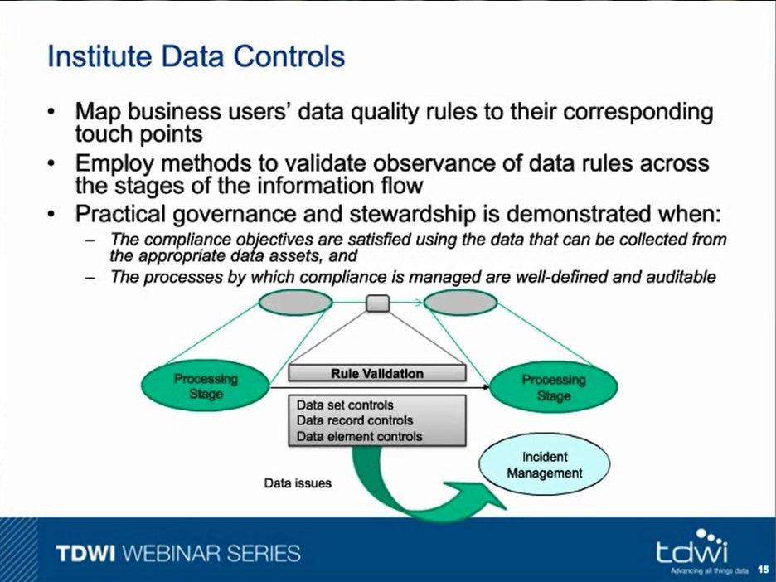

Slide 26
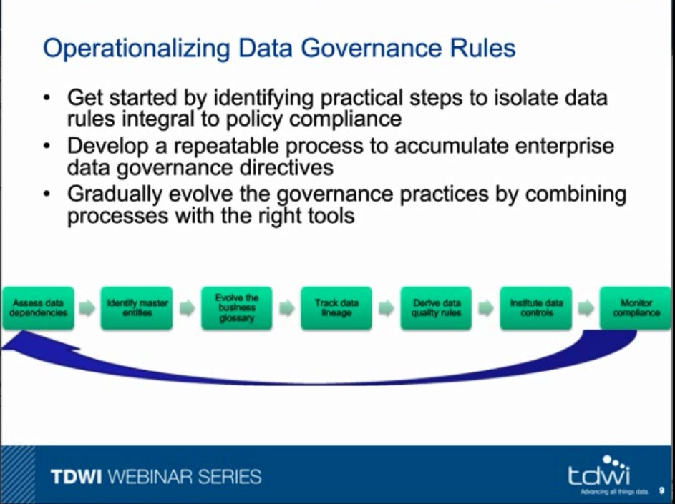

Slide 27
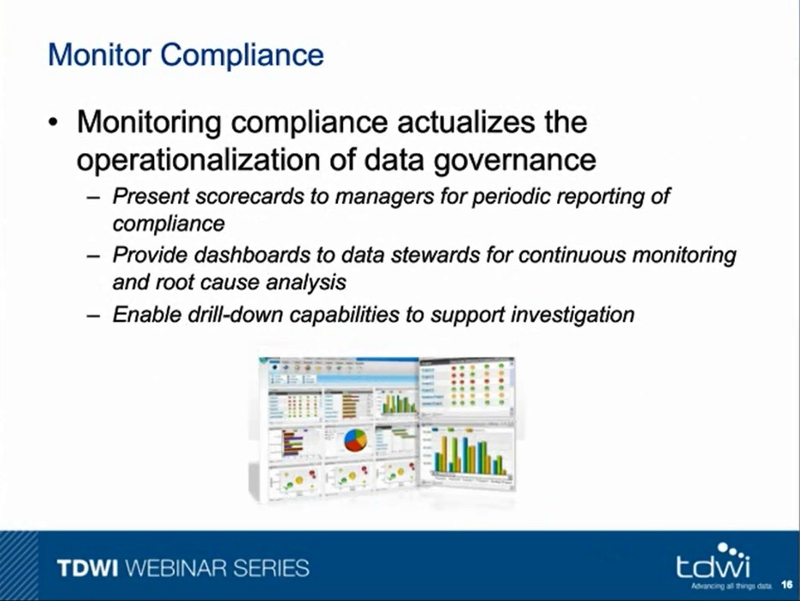

Slide 28
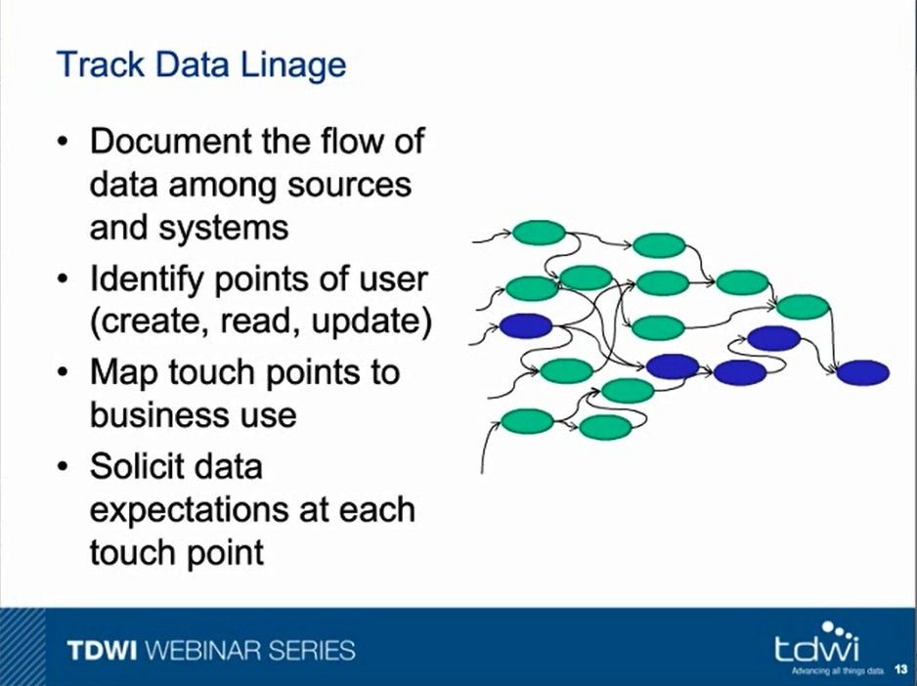

Slide 29











Informatica Success Story: Global 50 Leading Global Investment Bank
KEY BUSINESS IMPERATIVE
Enterprise-wide Multidomain MDM to Enable Straight through Processing.
The Challenge
Bank faced two key business challenges:
Maximizing trade automation (Straight-through processing)
Managing credit risk across clients and internal investments
Counterparties
Global Corporations
Medium Businesses
Small Businesses
Informatica Advantage
Bank deployed Counterparty Master MDM system to support Trade Execution and Credit Risk Management.
MDM system will keep hundreds of downstream trading systems synchronized with the most accurate legal entity information, ensuring that trades flow automatically without manual intervention.
Public Sector
Private Sector
Results / Benefits
Increased client satisfaction due to quicker trade execution.
Risk managers are able to view risk concentrations from any perspective.
$11M savings annually, freeing $300M to be invested elsewhere.
Business Use
End Users
Craig added value to the Bloomberg TradeFeed system so subscribers like Deutsche Bank could specify how trades are structured.
Trade Settlement
Credit Risk Management
Risk Managers
Traders
Notes:
SITUATION:
At this leading Global 50 investment bank, its CEO was getting complaints about failed and delayed trades.
BUSINESS PROBLEM:
As a result, they faced two key business challenges: • Maximizing trade automation Large firms like this company have dozens or even hundreds of trading platforms. Due to business pressures to rapidly launch into new markets and products, most trading platforms maintain their own Security and Counterparty reference data which is critical to trade automation. As a result: - These platforms were difficult to keep up to date which made it difficult to leverage business process outsourcing
- These platforms supported multiple external data service providers resulting in the need to buy more data than they needed
• Managing credit risk across clients and internal investments.
With new regulations in the international banking community (e.g. Basel II), firms are required to measure credit risk using a worldwide standard of calculation. This calculation requires banks to accurately aggregate exposures within a legal entity hierarchy. As a result: - The company often did not use legal entity identifiers within these trading systems making it difficult to identify the exact party and its organizational relationships
- There were no existing systems that were responsible for populating and tracking a comprehensive counterparty database.
ROOT CAUSE:
There were two key factors that led to this situation:
They lacked a centralized infrastructure to source legal entity and corporate organization data either internally or externally and to provide the processes and infrastructure to maintain high quality, trusted information.
Because there was no centralized repository of trusted information, there was no way to cross reference that to the accounts and exposures throughout the firm.
SOLUTION:
Informatica MDM worked with the company’s IT department to deploy a Counterparty Master MDM system to address both of these challenges. In support of Trade Execution, the MDM system keeps hundreds (200+) of downstream trading systems synchronized with the most accurate legal entity information related to the securities traded within that system ensuring that trades flow through automatically without manual intervention. Further, this mater database will cross reference exposures to each legal entity and provide the ability to summarize the exposure rolling up to the global parent.
BENEFITS:
By automating and centralizing the management of their counterparty reference data, the company has been able to reduce the amount of trade rework by 10% saving over $11 million annually in processing costs and freeing up over $300 million in capital to be invested elsewhere.

Slide 30
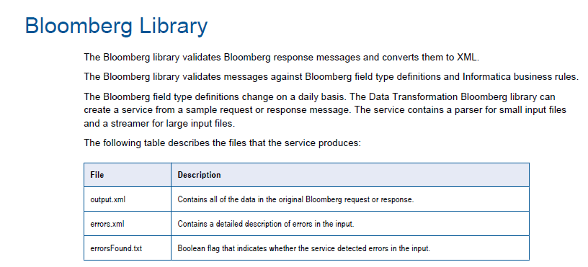
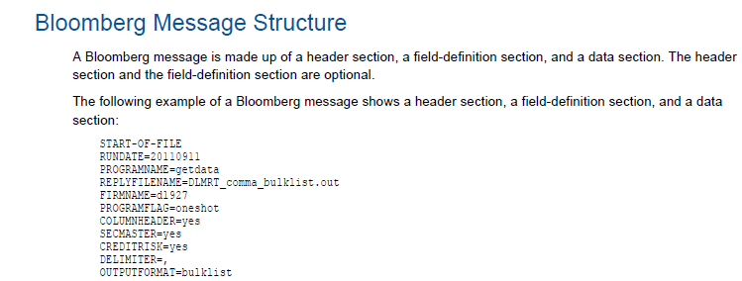
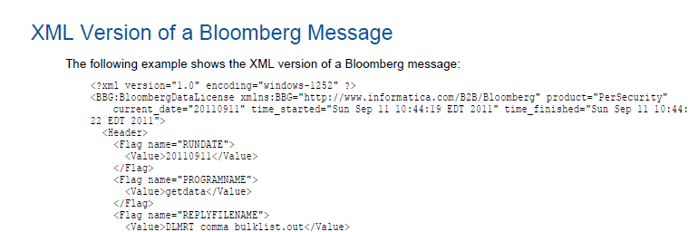

Slide 31
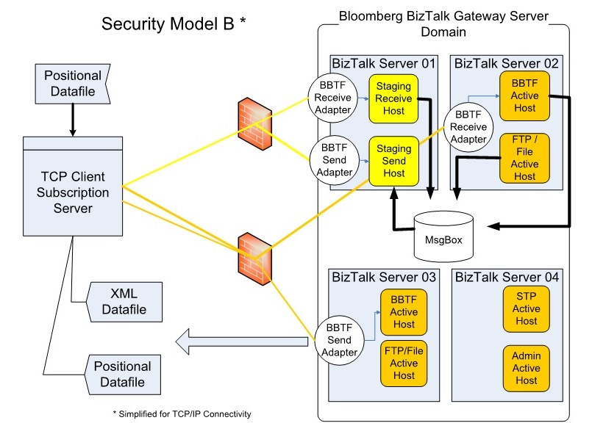

Slide 32







Oracle Legal Entity and Credit Risk Hub
Business Features
Complete and accurate view of the legal entity to feed risk analysis and other downstream trading systems
Aggregate risk exposure and profitability
Active monitoring of changes and transactions
Front Office/Customer Facing Applications
Business Users
SFA
Call Center
Trading
Desk
…n
ERM
Enrichment Sources
D&B
Real-time/near real-time Master Data
Data Stewards
Oracle Hub stores relevant counterparty reference data and associates transaction data creating rule based events
Legal Entity and Credit Risk Hub
Universal Customer Master
BANKSCOPE
Real time/ Batch
Master Data
Middleware
Data Quality
De-duplication
Party Data Model
Customer Management
Privacy
AVOX
Real-time/near real-time Master Data
IT Features
Persists master data with references to transactional data
Complete metadata management
Rules-based configuration
Service-oriented architecture
Application Integration Foundation
Collateral
Mgmt
Limit System
Internal Ratings
Risk Analysis
Scenario
Analysis
Security Master
…n
Business Users
Downstream Applications

Slide 33
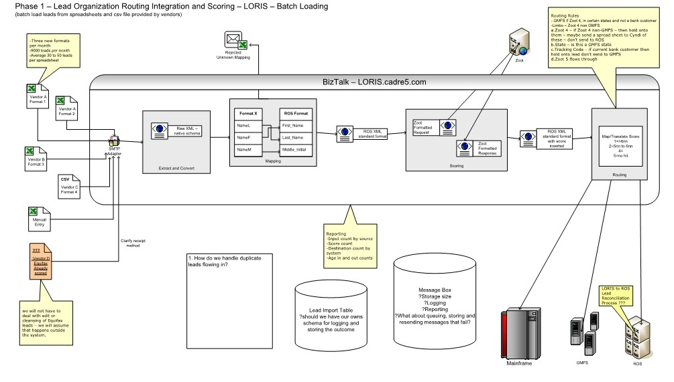

Slide 34

































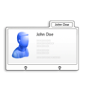







Informatica MDM Hub Functionality
Core Capabilities
Hub API
Integrate
Schedule Group
Get Batch Group Status…
Batch
Near Real-time
Real-time
Data Interaction
Consume
Create Customer
Get Sales Transaction…
Business Interaction
Sync
Federate
Govern
Get Matched Records
Set Record State…
Data Governance
Workflow
State Mgmt.
Data Security
Secure
Row & Column Level Security
Authenticate User
Register User…
Authentication
Authorization
Relate
Party & Product
Add Product Relationship
Delete Party Relationship…
Party
Product
Consolidate
Trust Framework
Merge Records
UnMerge Records…
Link
Merge
Match
Search Party
Search Product…
Deterministic & Fuzzy Logic
Internationalization
Enrich
Get DnB Tree
Get Axciom ID…
Data Mastering
Organization
Demographics
Cleanse Address
Standardize Product Name…
Cleanse
Data Transformation
Open Cleanse Architecture
Standardization
Multi-Entity
Metadata
Get Party
Add Product…
Content
Configuration
Model
History
Lineage
Match
Survivorship
Validation Rules
Party
Product
Notes:
The unique ability of handling multiple domains on the same platform is depicted well on this slide.
During implementation the Administrator will use the MDM config console. It has a series of workbenches, one for each layer of this architecture. You literally start with the workbench for the data model layer which is of course foundational to any data management system, and then work your way up thru the layers where you’ll configure DQ rules, match rules, merge rules, security and so on. But let’s focus on the data model layer. It is 100% extensible or you can import your own data model.
The great thing is, all the layers above the data model are “model-aware” and conform their services to it. So, for example, when you go to configure match rules, the workbench for match rules will show you all of the attributes from the data model you have at your disposal for use in configuring match rules. The same is true for the other layers.
CLICK
Notice there are APIs that will be automatically generated and will reflect your specific configuration. So if you have a party entity in your data model, you’ll see a service in the API called “Get Party”, this type of “awareness” will occur across all the layers of the architecture.
So when we talk about Multi-Domain with the Informatica MDM Hub, unlike the other vendor’s products, we really mean “Multi-Domain with no breakage from the rest of the platform”.

Slide 35
OAGIS Business Object Document The common XML message structure provided by OAGIS is the Business Object Document (BOD,) which provides a message architecture based on the following reusable components: Nouns - Nouns describe a common business object and are composed of Components, which are basic building blocks shared across all Nouns. Verbs - Verbs describe the action to be applied to the Noun.
For example, the ProcessPurchaseOrder BOD
is constructed from the PurchaseOrder Noun and the Process Verb.
All BOD messages are based on common Nouns combined with a Verb.
Additionally, all BODs contain an application information area used by the processing infrastructure for routing, authorization and receipt verification.
Notes:
OAGIS BODs provide entity models for B2B interchanges in lieu of other Master Data models. (Notice the similarity with PowerShell syntax)

Slide 36
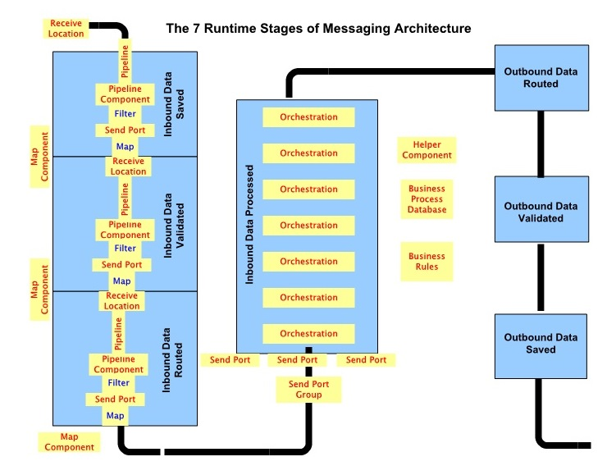
Notes:
For 100+ companies over a 10 year period, I used this Flo Technologies model for implementing workflows for data and business process integration.

Slide 37
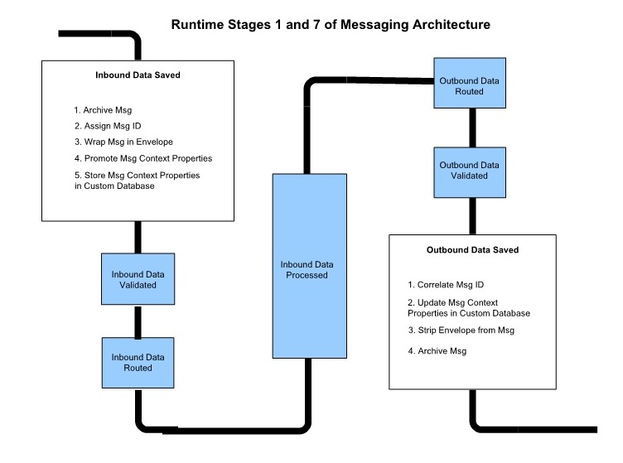

Slide 38
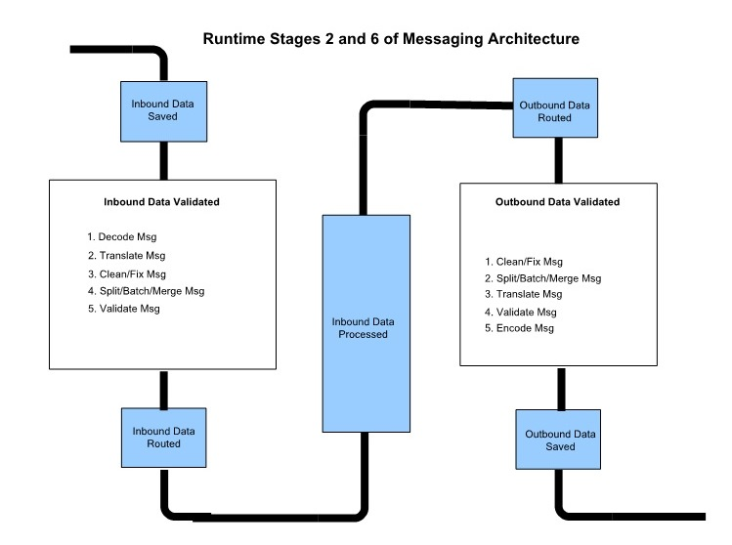

Slide 39
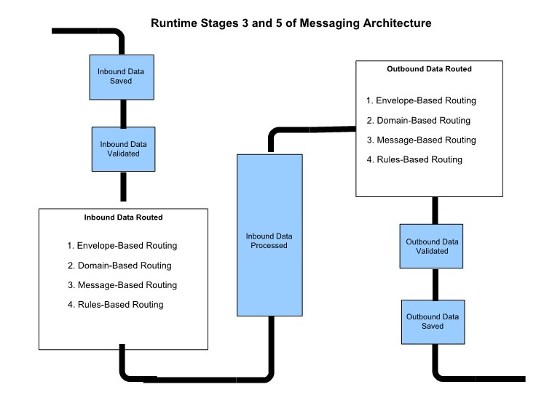

Slide 40
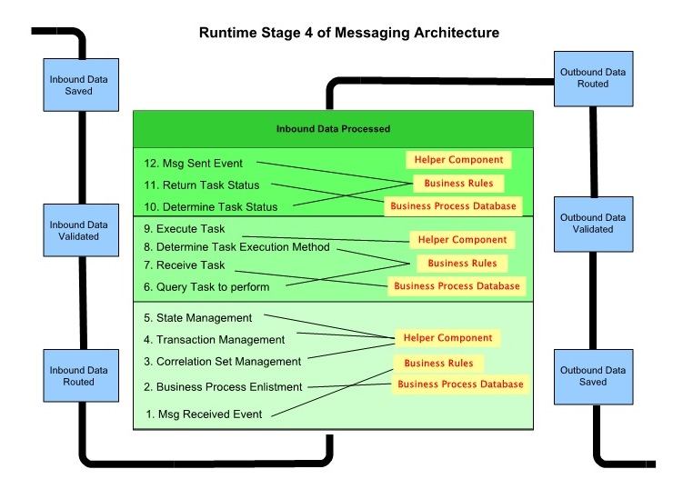

Slide 41
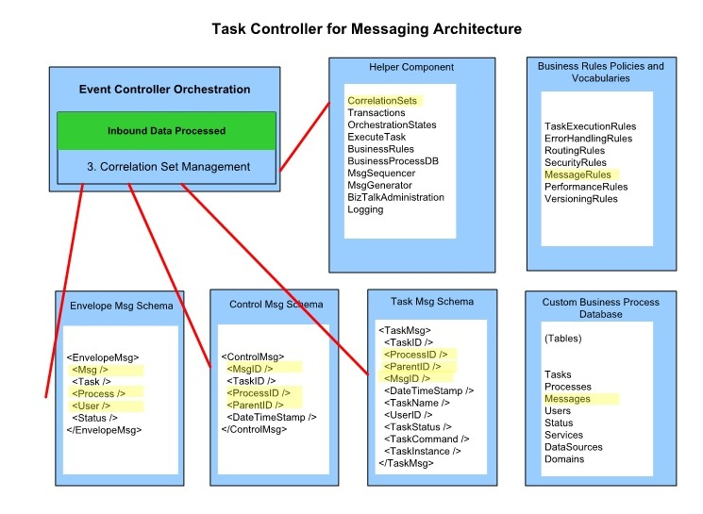

Slide 42
Data Quality Scorecards are built on Data Quality Assessments
GOOD BAD SEPARATION REPORT FOR SCORE2 IN DATA MDL2
MAXIMUM KS = 60.6234 AT SCORE POINT 0.2469
( AUC STATISTICS = 0.8858, GINI COEFFICIENT = 0.7715, DIVERGENCE = 2.8434 )
MIN MAX GOOD BAD TOTAL BAD CUMULATIVE BAD CUMU. BAD
SCORE SCORE # # # RATE BAD RATE PERCENT PERCENT
--------------------------------------------------------------------------------------------------------
BAD 0.6877 0.9677 2,011 7,989 10,000 79.89% 79.89% 34.00% 34.00%
| 0.4749 0.6876 4,300 5,700 10,000 57.00% 68.45% 24.26% 58.27%
| 0.3125 0.4748 6,036 3,964 10,000 39.64% 58.84% 16.87% 75.14%
| 0.1932 0.3124 7,451 2,549 10,000 25.49% 50.51% 10.85% 85.99%
| 0.1142 0.1932 8,379 1,621 10,000 16.21% 43.65% 6.90% 92.89%
| 0.0646 0.1142 9,055 945 10,000 9.45% 37.95% 4.02% 96.91%
| 0.0345 0.0646 9,533 467 10,000 4.67% 33.19% 1.99% 98.90%
| 0.0166 0.0345 9,800 200 10,000 2.00% 29.29% 0.85% 99.75%
| 0.0062 0.0166 9,946 54 10,000 0.54% 26.10% 0.23% 99.98%
GOOD 0.0001 0.0062 9,995 5 10,000 0.05% 23.49% 0.02% 100.00%
====== ====== ====== ====== ======
0.0001 0.9677 76,506 23,494 100,000

Slide 43
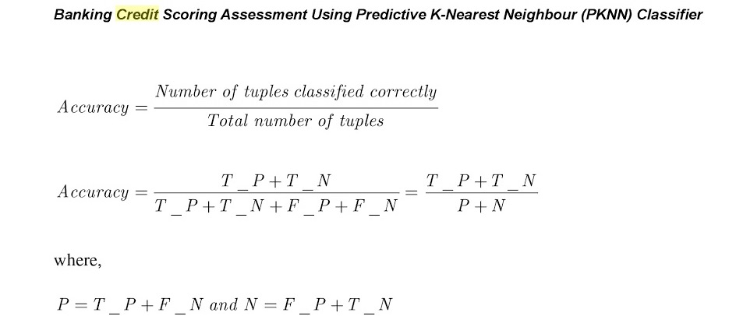

Slide 44
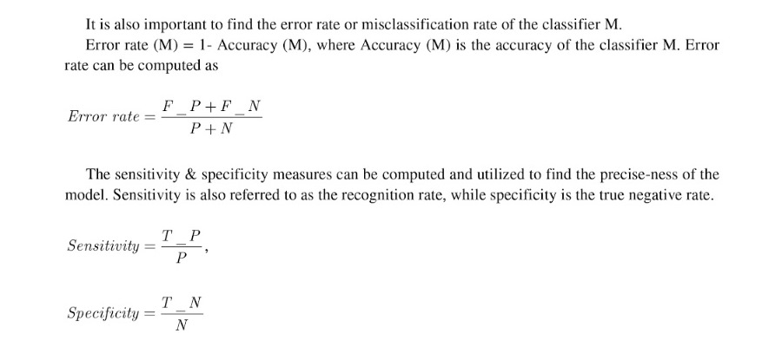

Slide 45
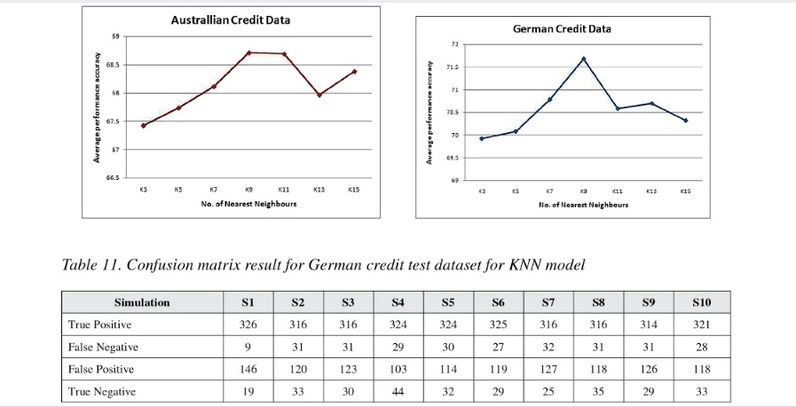

Slide 46
